Slide 1

Christmas Tree Decoration
Author： Kaihua Hu & Yi Zhao

Slide 2

Purpose
The season of Christmas is coming. Everyone wants a dreamed Christmas tree but not everyone has a chance to have one due to financial reason, space limitation or clean up issue .The Christmas tree decoration app allow users to decorate a virtual Christmas tree inside their house. The user can manipulate the mechanical arm (lower arm, upper arm and hand) to grab ornaments and put them on tips of the tree.

Slide 3
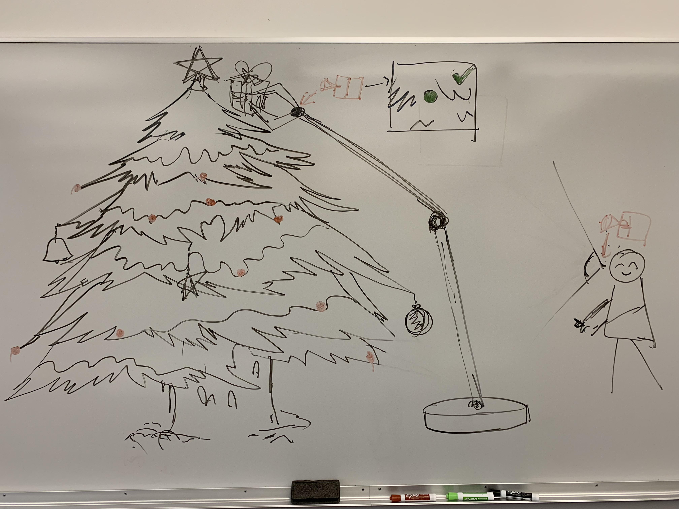
Want a Christmas tree to decorate?

Slide 4


Project Requirements
Graphical Objects Hierarchy
Christmas tree
Hanging spots
Mechanical Arm
Base
Lower Arm
Upper Arm
Hand
Oranments

Slide 5
Project Requirements (con.)
Objects Interaction
Hand
Grab an ornament
Put it on the tree (release).
Hanging spots
Originally white
Change to red when touching an ornament

Slide 6
Project Requirements (con.)
Illumination and texture
Ornaments
Some of them are lights.

Slide 7
Project Requirements (con.)
Two Different Views and Camera manipulation
Main Camera
Locate at eye position
Small Camera
Locate at hand

Slide 8

Timeline
Milestone | Schedule | Status
Proposal | Nov. 15 - 19 | In process
Objects Hierarchy and Texture | Nov.20- 26 | In process
Object Interaction and Camera view | Nov. 27 – Dec 3
Testing | Dec. 4 -10

Slide 9

Thank you!

